Slide 1
Layout & Debugging in CSS
Sandeep G

Slide 2
Who Am I?
Engineer / Front End developer
Worked in Software AG, MSFT, SAP
~9 years of experience
Worked in React JS, TypeScript, JS, CSS, HTML

Slide 3

Agenda
FlexBox layout
Grid Layout
Debugging in CSS

Slide 4
Flexbox

Slide 5
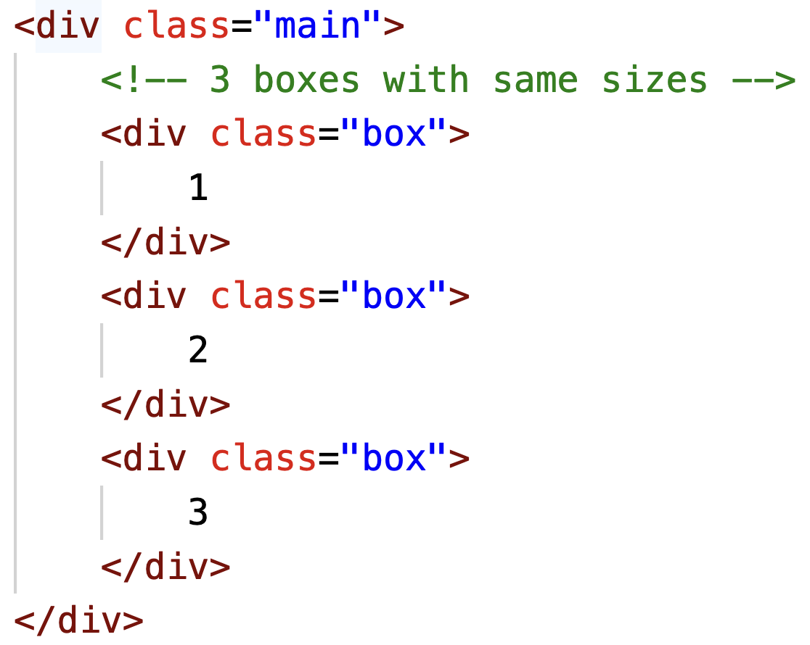
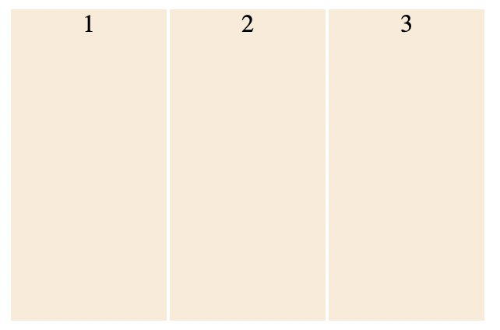
Flexbox -display:flex
display:flex
Helps to simplify the positioning of elements in webpage.
Two important components of flexbox -
Flex container - Parent element having ‘flex items’ as child. Have the css property - display:flex.
Flex items - Direct child of the above mentioned type of parent.
Usage -
Helps to make our website responsive with less complications.
In other words - it helps to create websites which responds to screen change.

Slide 6

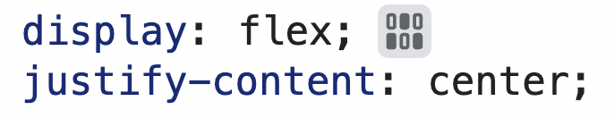
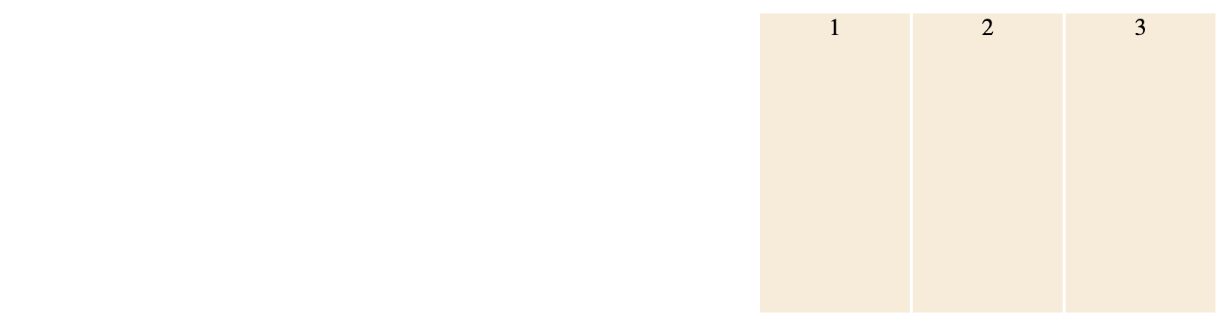
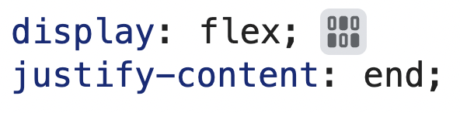
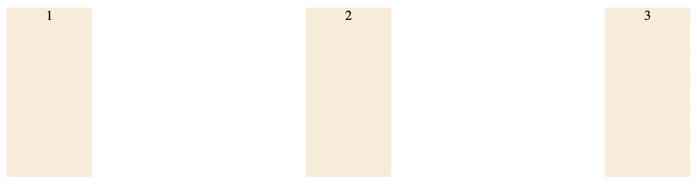
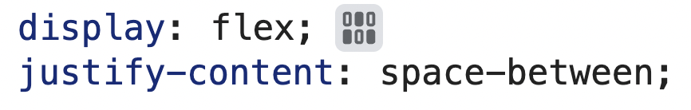
justify-content
display:flex
It is helpful in aligning the containers in the screen.

Slide 7
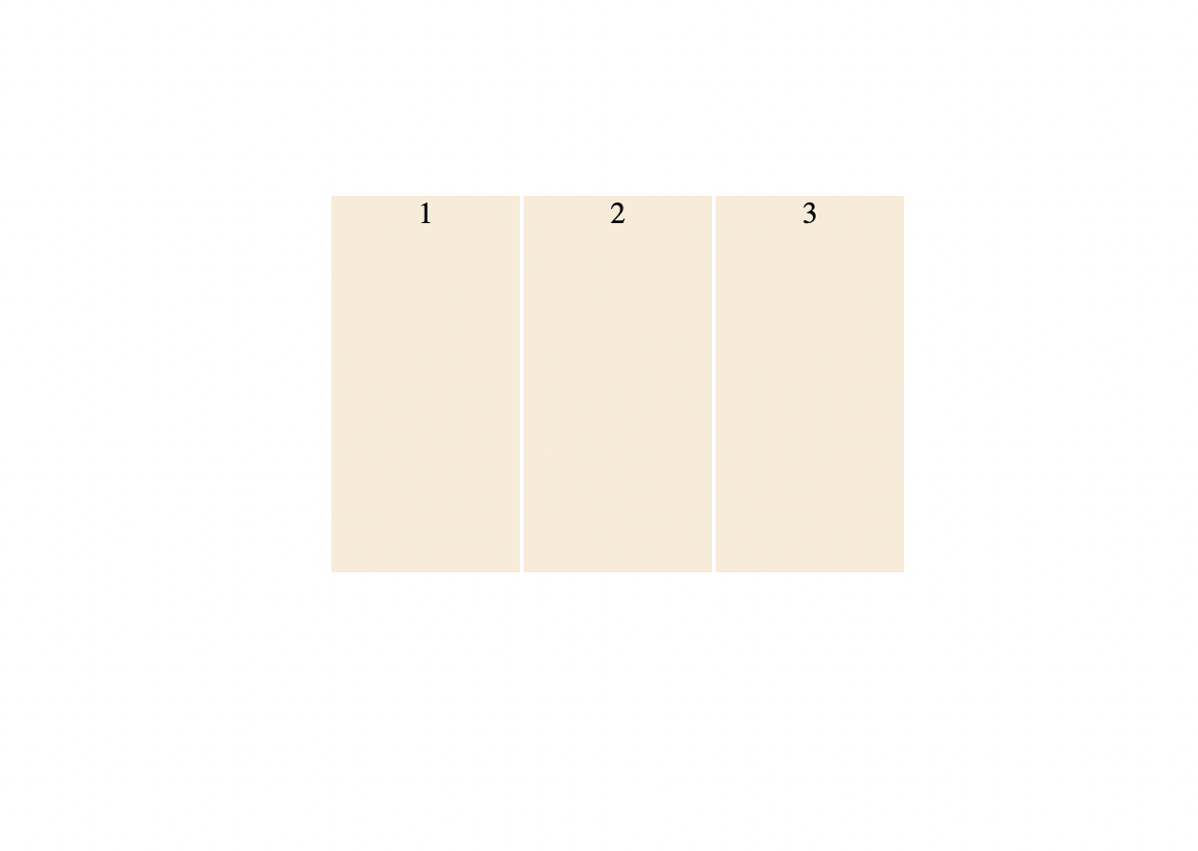
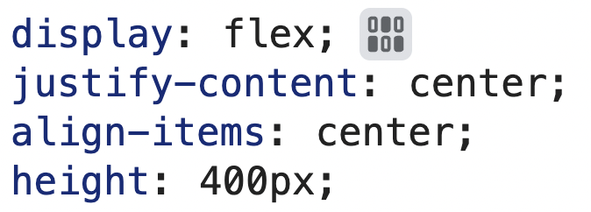
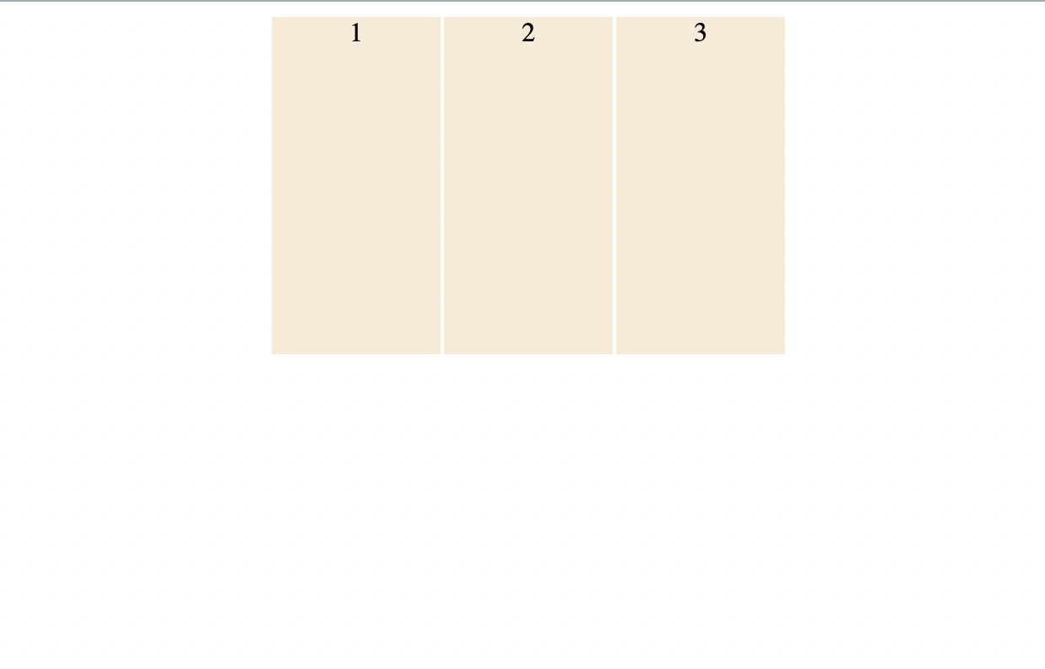
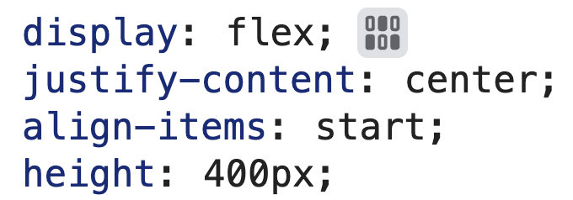
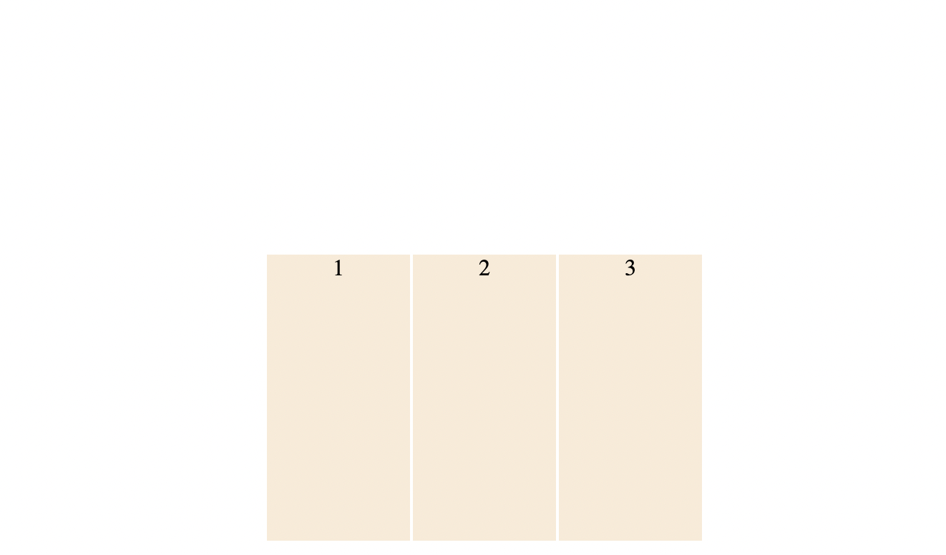
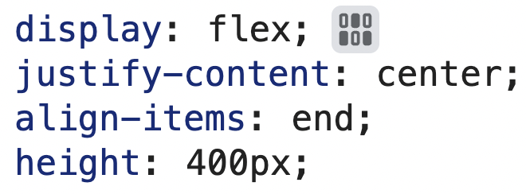
align -items
Helps in aligning items, vertically in a container. Setting height is a ‘must’.

Slide 8
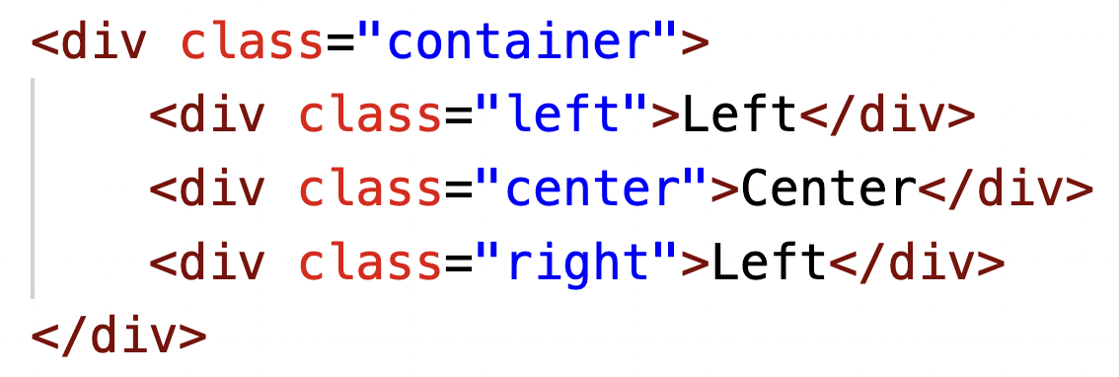
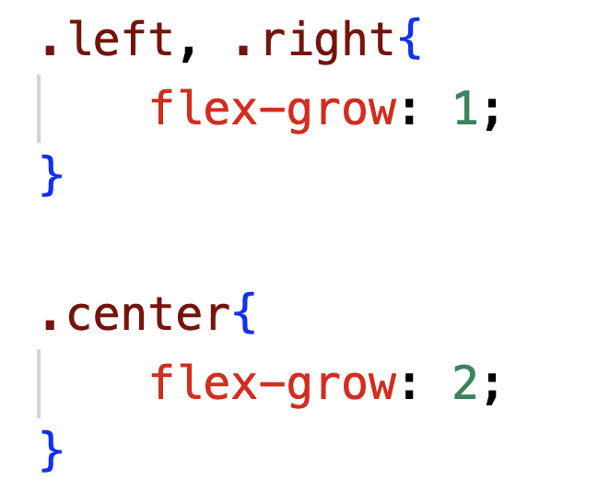
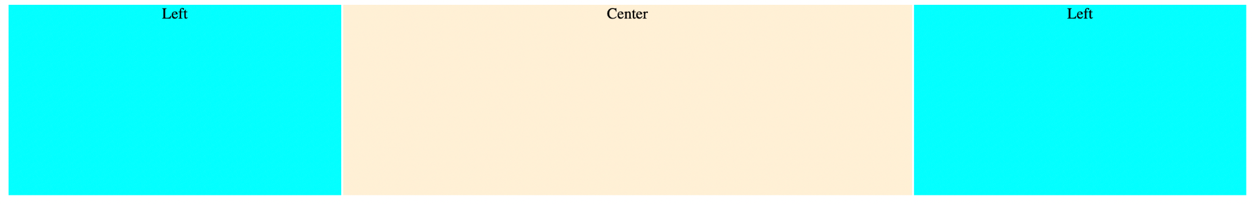
Flex grow
Allows us to specify if item should grow to fill a container. Also, which item should grow more than others.
Left : right: center 1:1:2

Slide 9
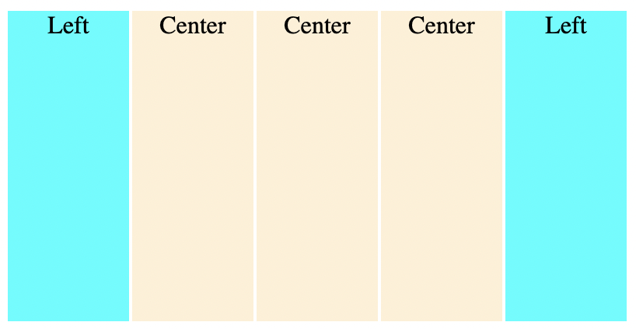
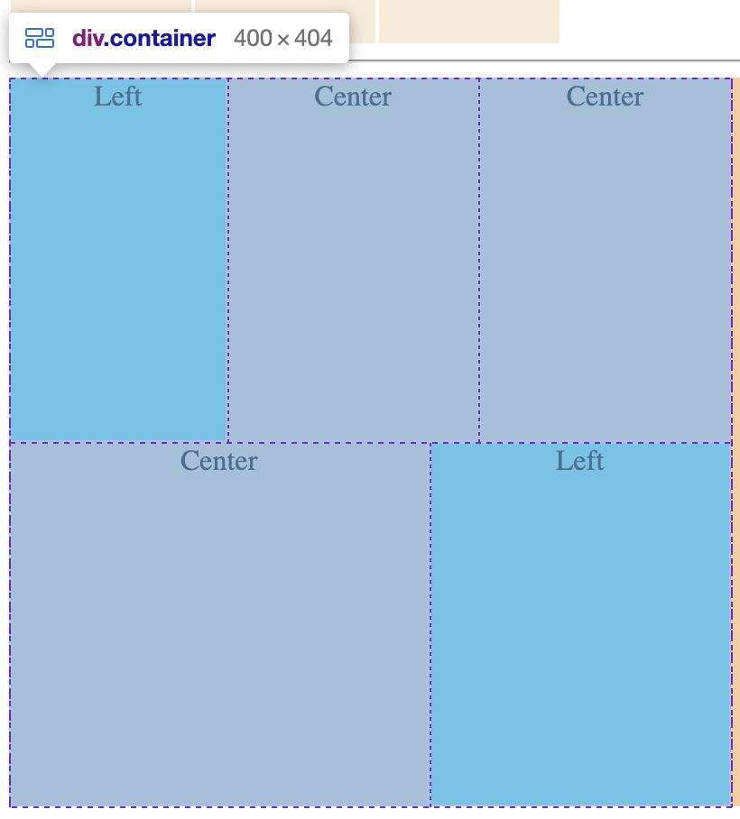
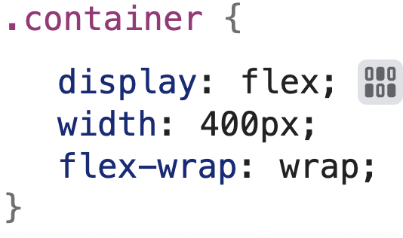
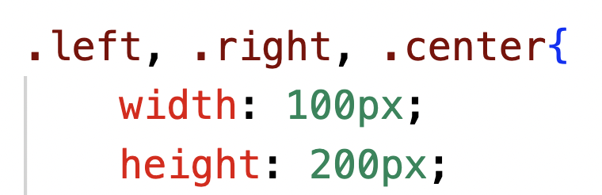
flex-wrap
Enable us to move the element to move to the next line, if necessary.

Slide 10
Explore other flex property yourself.

Slide 11
Layout with Grid

Slide 12
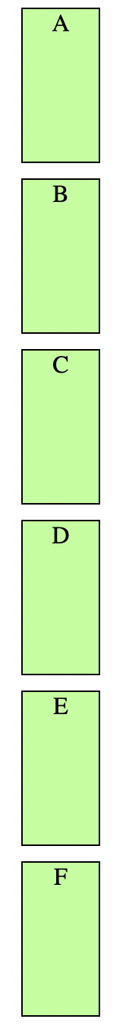
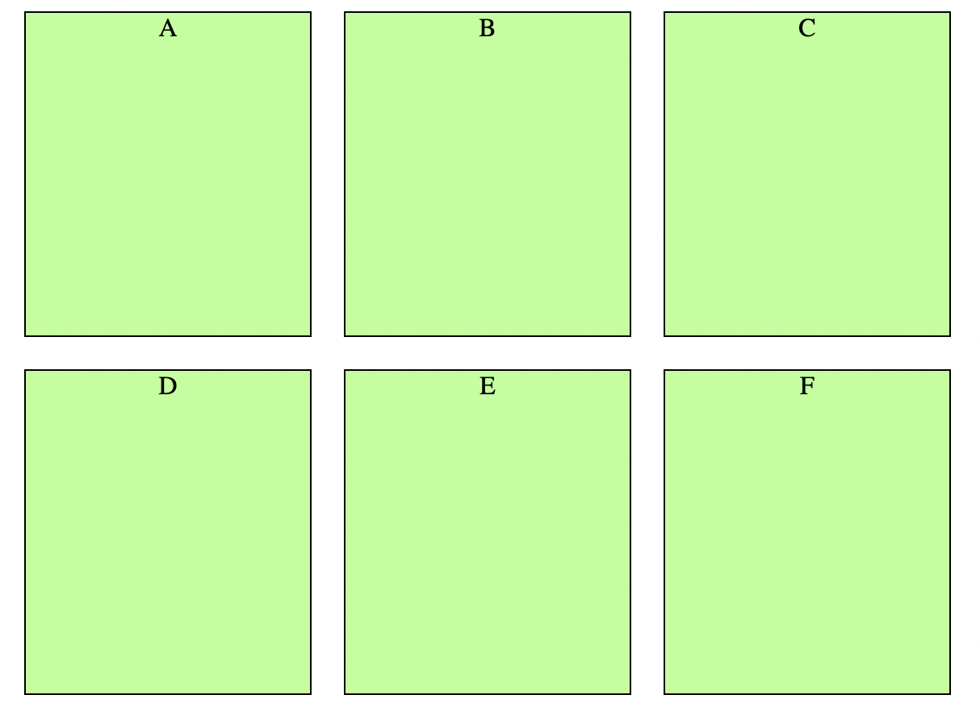
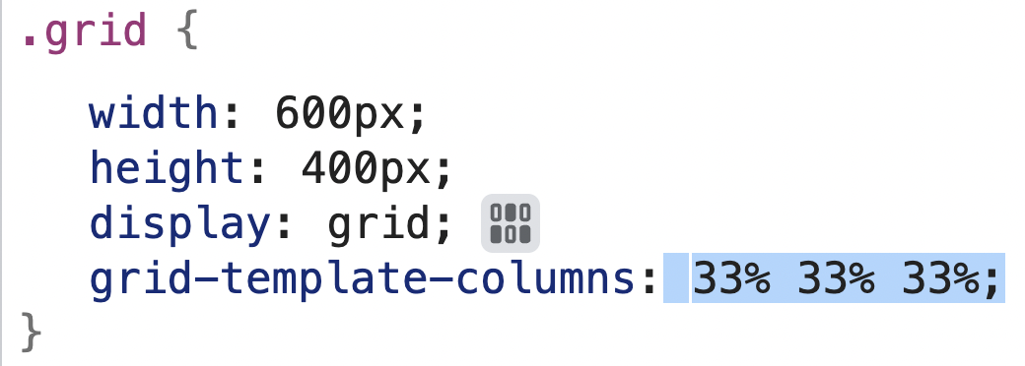
CSS Grid
Flexbox is useful in 1-D layout, Grids are useful in layouting in 2-D.
We can enable the grid in CSS, with the option display:grid.
By default, we just have 1 column, and new elements are added to a new row.
In order to add columns we have to use the property - grid-template-columns.

Slide 13
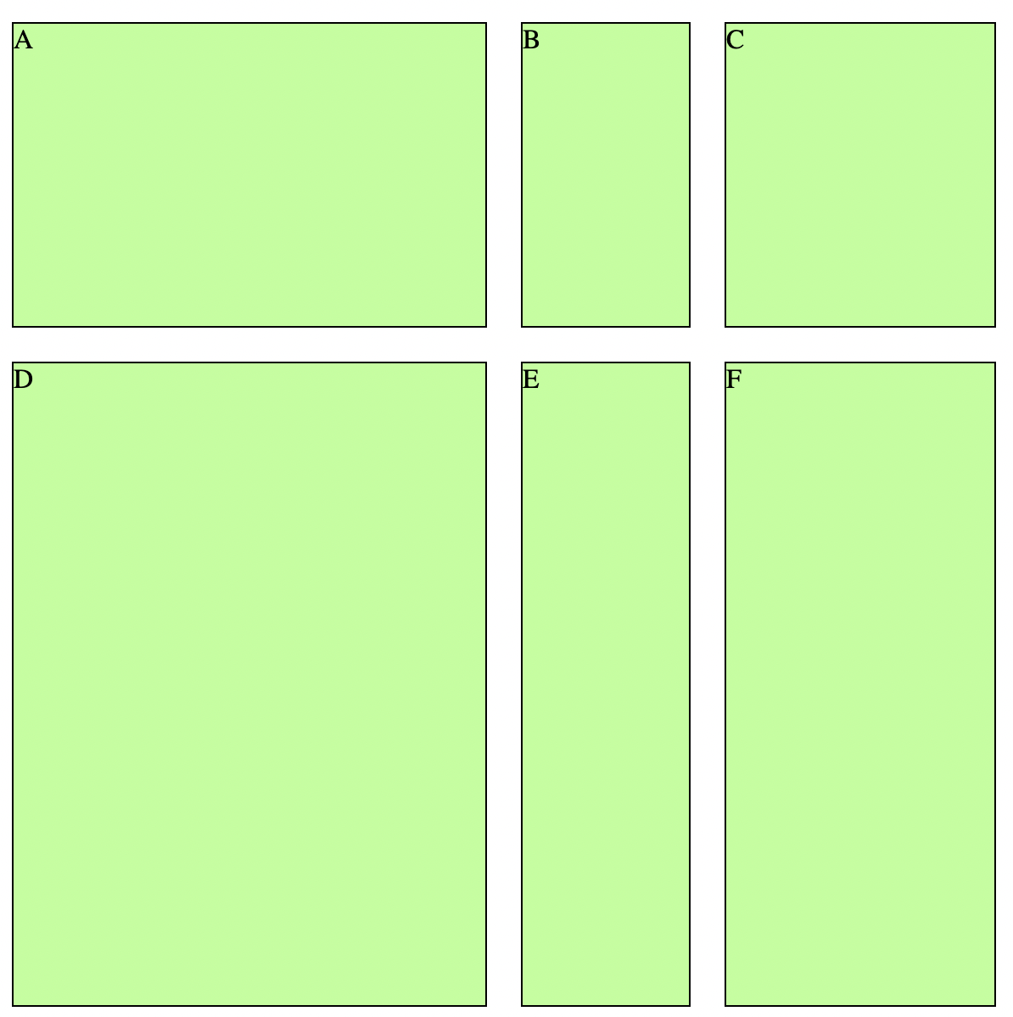
Grid template
Previously mentioned grid-template-params can be replaced by grid-template.
Grid-template is written in the following format -
height-row1 height-row2 / <column ratios>

Slide 14
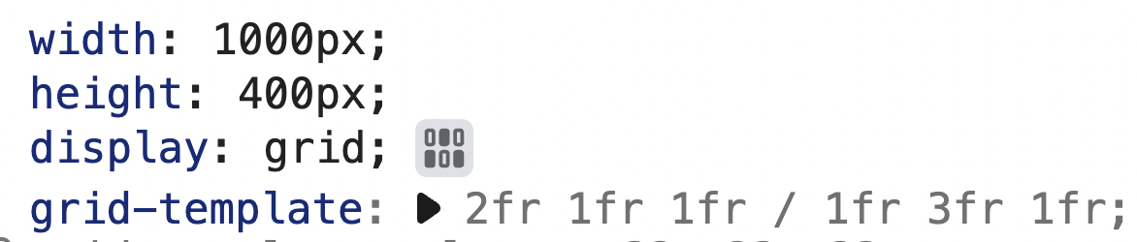
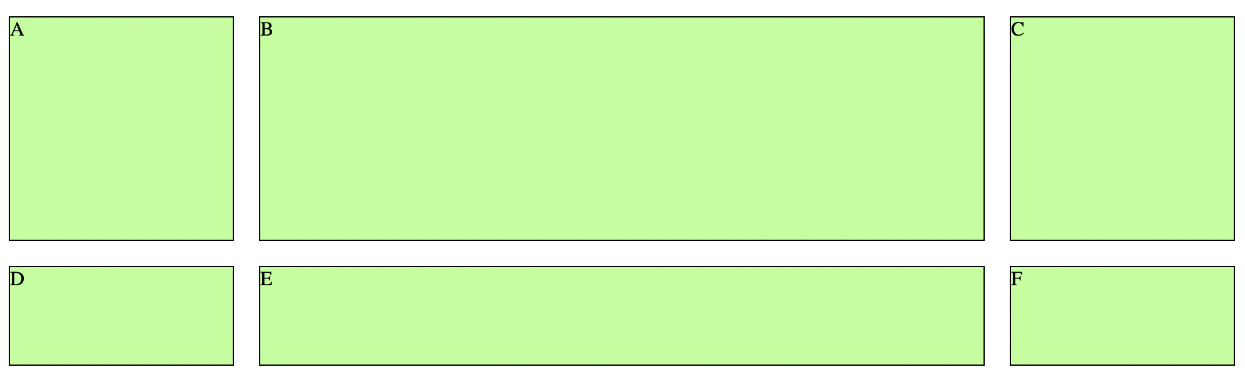
Grid with fr (fraction)
Size of the column can also be defined by ‘fr’ which is fraction of the grid’s length and width.
Row / column = height / width 2fr = (2/4)*400 = 200px; 1fr = (1/4)*400 = 100px; ~ 200px 100px 100px / ___ ___ ___

Slide 15
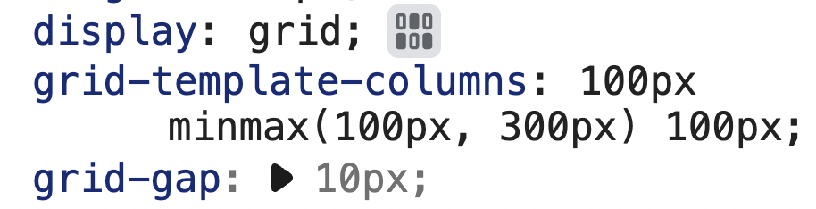
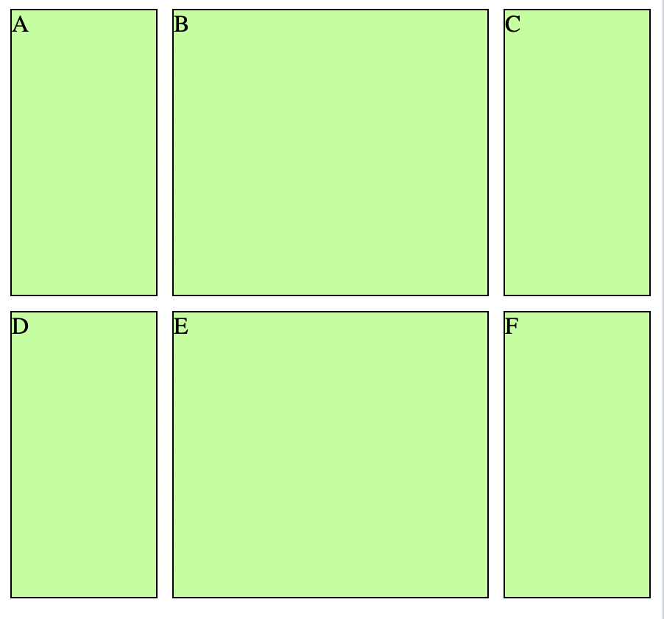
Misc Grid properties
Repeat Property -
Shorthand property to write grid template -
The above example create 3 columns with 100px each.
Minmax Property -
Helps in creating a column of varying width, in the given range.
In the above example 1st and 3rd row will always be 100px, but 2nd row will grow from 100 to 500px, when we change the screen size.
Grid gap property -
Instead of giving a margin around the box, we may add grid-gap to add space between.

Slide 16
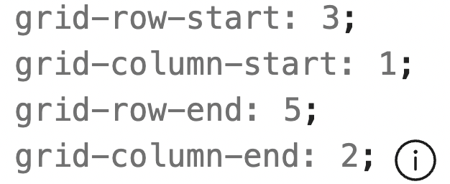

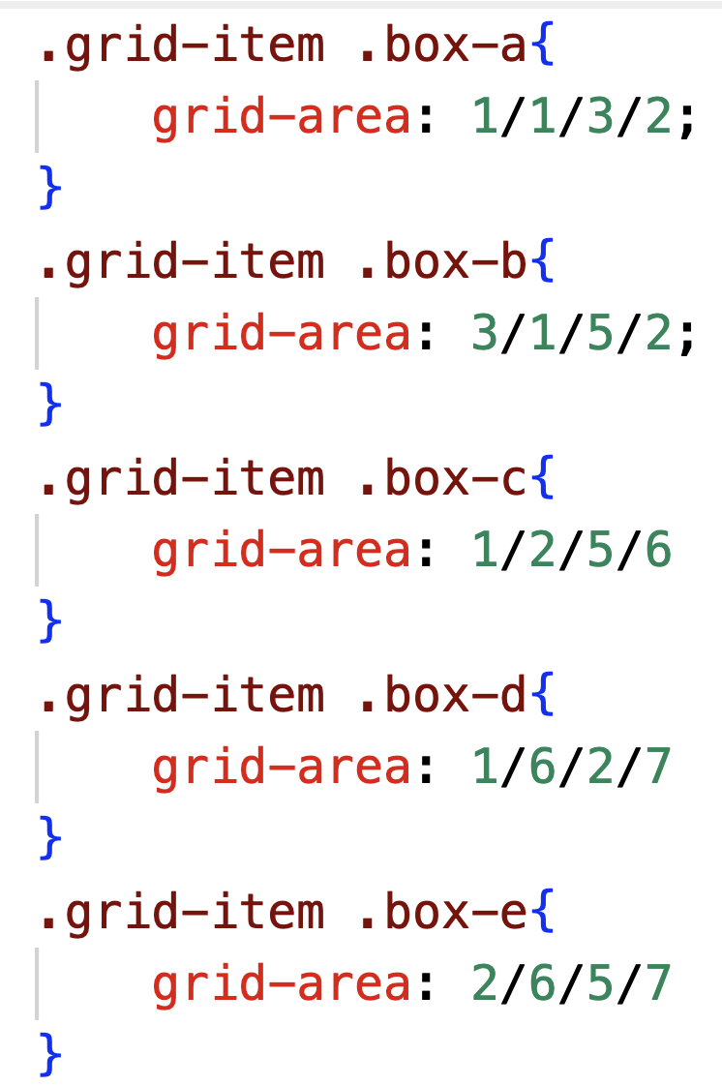
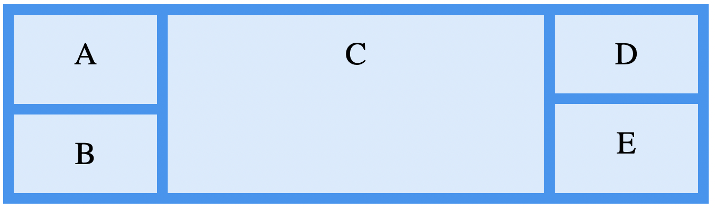
Multiple Row items
We can create the grid layout using the property grid-area -
Test in W3Schools - W3Schools Tryit Editor

Slide 17
Thanks and Happy coding!

